Slide 1


Real-Time Stock Market Data Pipeline
FDE Project Review-3
COURSE CODE:24DEA3101
WEDNESDAY, September 16th, 2026
 | Under the Guidance of Dr. N.Sirisha Assistant Professor, Department of Computer Science and Engineering, KLH Bowrampet Campus
Team Members M.VENKATA AVINASH 2420030458 SHAGA YASHWANTH 2420030624 SYED MUSAIB 2420090109
16 September 2026
FDE Project Review-3

Slide 2
PROJECT OVERVIEW
Developed a Data Engineering pipeline for continuously changing stock-market data.
Stock data is obtained through a Financial REST API.
Python based modules perform ingestion, cleaning and transformation.
Processed data is stored in PostgreSQL.
Streamlit and Plotly are used to provide interactive visualization.
The complete flow connects data acquisition → processing → storage → visualization
Pipeline
API → Ingestion → Cleaning → Transformation → PostgreSQL → Dashboard
16 September 2026
FDE Project Review-3
COURSE CODE : 24DEA3101

Slide 3
IMPLEMENTED METHODOLOGY
1. Data Acquisition
Financial REST API
↓
2. Data Ingestion
Python-based automated retrieval
↓
3. Data Validation & Cleaning
Missing values • Duplicates • Data types
↓
4. Data Transformation
Standardization • Timestamp formatting
↓
5. Data Storage
PostgreSQL
↓
6. Visualization
Streamlit + Plotly
16 September 2026
FDE Project Review-3
COURSE CODE : 24DEA3101

Slide 4
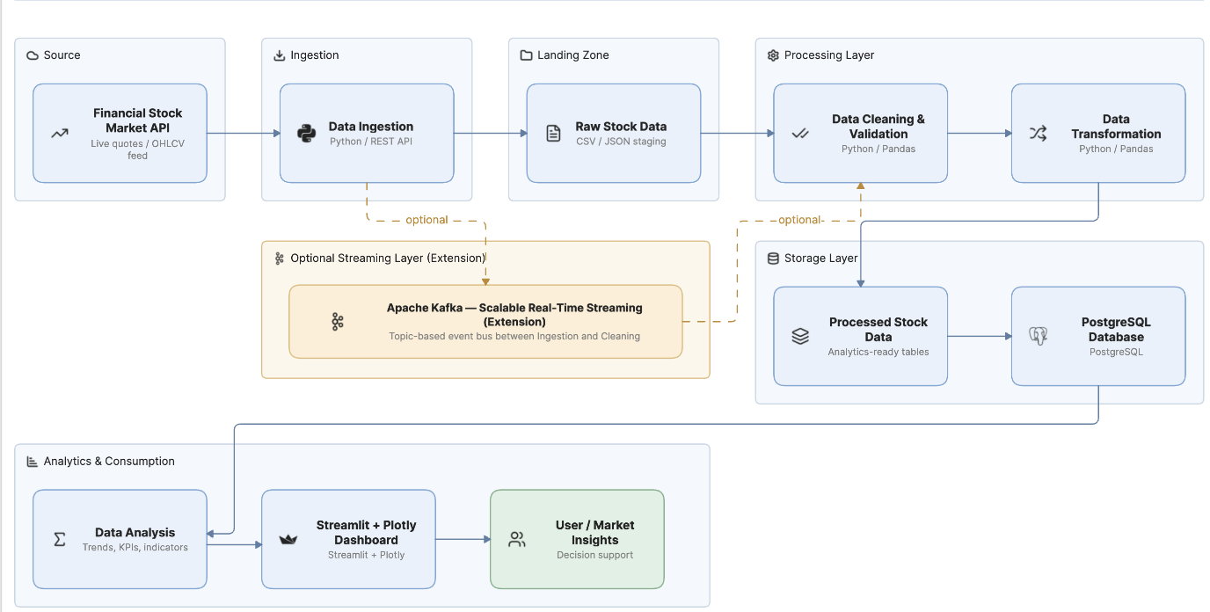
SYSTEM ARCHITECTURE
16 September 2026
FDE Project Review-3
COURSE CODE : 24DEA3101

Slide 5
IMPLEMENTATION WORKFLOW
Stage | Implementation
Data Source | Financial REST API
Ingestion | Python
Cleaning | Pandas
Transformation | Pandas
Storage | PostgreSQL
Visualization | Streamlit
Charts | Plotly
API → Python → Pandas → PostgreSQL → Streamlit/Plotly
16 September 2026
FDE Project Review-3
COURSE CODE : 24DEA3101

Slide 6
TECHNOLOGY STACK
Technology | Implementation
Python | Pipeline development
REST API | Stock data acquisition
Pandas | Cleaning & transformation
PostgreSQL | Data storage
Streamlit | Dashboard
Plotly | Interactive charts
Git & GitHub | Version control
Future Extension: Apache Kafka
16 September 2026
FDE Project Review-3
COURSE CODE : 24DEA3101

Slide 7
CONCLUSION
- The Real-Time Stock Market Data Pipeline provides an automated approach for collecting, processing, storing and visualizing continuously generated stock-market data. The project demonstrates core Data Engineering concepts while providing a foundation for scalable real-time analytics.
16 September 2026
FDE Project Review-3
COURSE CODE : 24DEA3101

